Slide 1
3-Way Builder Follow Up Call
Allyse Sedivy
Triple Diamond

Slide 2
Start the call by referring to something they said in the previous call. This builds a lot of trust and credibility, and allows you can go back to the same place you were on the first call.
This call is where you need to talk, not just listen.

Slide 3
Step 1
Get Realistic.
“Ok, I’ve been thinking about you and the goals and dreams you shared with me. I’m really excited about what you’ve told me, and I have a question to ask you: Would you like me to be realistic with you today, or tell you what you want to hear?”

Slide 4
“We’ve watched a lot of people build this business, and we have seen many people become successful in this business. We’ve been able to gather averages with thousands of people building the business to see how long it takes and how much time they put in on a weekly basis, and how much money they make as a result.”

Slide 5
“Now, I don’t think I’m average, and I don’t think you’re average - and together I definitely don’t think we’ll be average. But it’s good to have these averages so we have a good starting point.”

Slide 6
Step 2
Talk about Business Goals.
“Let’s look at your goals. You told me you’d like to be earning $________ by (date)________. If I look at a chart with company averages, that’s about __________ rank.”

Slide 7
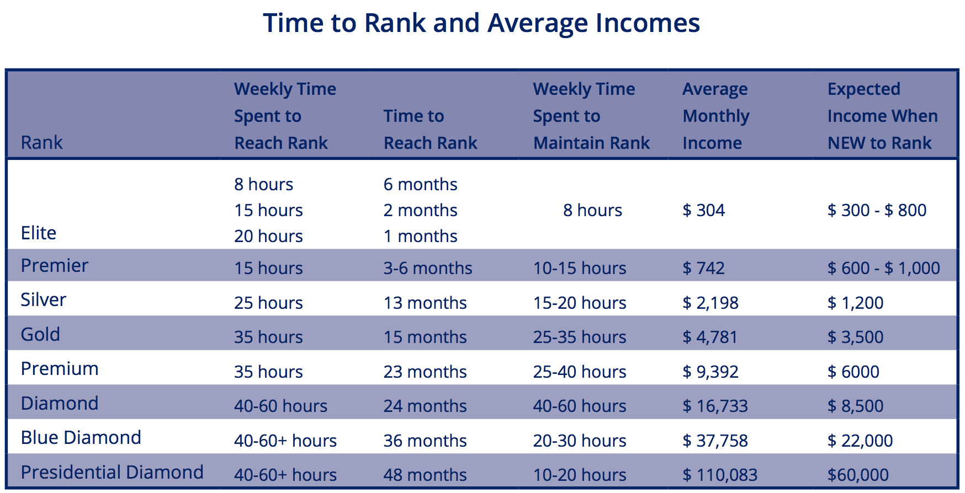
Platinum

Slide 8
This averages chart also tells us that (their target rank) typically takes (x number of months) to achieve. So to be realistic, one of these numbers needs to change…

Slide 9
“Either you could increase the hours you work, or increase the length of time it will take to get there. What would you be willing to adjust?” (Let them answer)

Slide 10
Step 3
Set a goal.
Adjust numbers until you have a realistic goal. (i.e. “Ok, so you want to do 10 hours a week, and in 3 months you want to be making $1,000 per month. Would it be ok if we made the goal 15 hours instead of 10?”)

Slide 11
Platinum

Slide 12
If someone says they want to put in fewer than 15 hours a week, say, “I have never seen anyone make significant residual income working fewer than 15 hours a week. 15 hours is really the minimum time to gain the momentum you’ll need.”

Slide 13
Settle on a goal and timeframe they feel positive about. Then tell them you’ll both try to overshoot the goal (which most people will be very happy with!)

Slide 14
Step 4
Start at the very beginning of the business by making a list and teaching them how to sample, follow up and invite properly. You will be using 6 Weeks to Elite when they launch their business.

